Slide 1
EUROPEAN PILLAR OF SOCIAL RIGHTS
#SocialRights

Slide 2
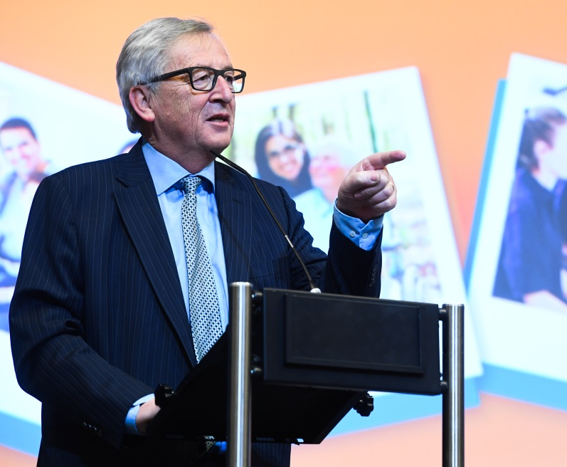
President Jean-Claude Juncker announced the establishment of the European Pillar of Social Rights in his State of the Union adress in the European Parliament on 9 September 2015.
On 26 April 2017 the Commission delivered on its promise to adopt its proposal for the European Pillar of Social Rights.

Slide 3
What is the European Pillar of Social Rights?
A reference framework for upwards convergence
Building on the existing EU social law
A scoreboard of employment and social indicators
Several concrete initiatives
20 principles and rights

Slide 4
What is the European Pillar of Social Rights?
20 principles and rights
Equal opportunities and access to the labour market
Education, training and life-long learning
Gender equality
Equal opportunities
Active support to employment
Secure and adaptable employment
Fair working conditions
Wages
Information about employment conditions and protection in case of dismissals
Social dialogue and involvement of workers
Work-life balance
Healthy, safe and well-adapted work environment
Adequate and sustainable social protection
Childcare and support to children
Social Protection
Unemployment benefits
Old age income and pensions
Minimum income
Health care
Inclusion of people with disabilities
Long-term care
Housing and assistance for the homeless
Access to essential services

Slide 5
Putting the Pillar into action: a joint effort
Update EU legislation, step up enforcement
Social dialogue
Funding
Civil Society
European Semester

Slide 6
First initiatives
Work-life Balance:
Directive + policy measures
Access to social protection:
Social partners' consultation
Information rights for workers:
Social partners' consultation on the Written Statement Directive (91/533/EEC)
Working Time:
Legal guidance on Directive 2003/88/EC

Slide 7
Monitoring societal progress
Social Scoreboard
To serve as a reference framework to monitor employment and social performances of Member States in a holistic way
12 areas along three dimensions of 'societal progress':
To be used in the framework of the European Semester, in particular in the Joint Employment Report
Equal opportunities and labour market access
Dynamic labour markets and fair working conditions
Public support, social protection and inclusion
14 headline and 21 secondary indicators
Based on existing data from e.g. EU-LFS, EU-SILC, the Structure of Earnings Survey and the OECD's PISA survey

Slide 8
Elements of the social package of 26 April 2017
The Pillar
Chapeau communication
Commission Recommendation with 20 principles
Identical draft for a Joint Proclamation of Parliament, Council and Commission
SWD: short fiche on each principle
SWD: a scoreboard showing progress on employment and social indicators
SWD: a consultation report
Accompanying initiatives on
Work-life balance
Access to Social Protection
Written Statement Directive
Working Time Directive
Other elements
Investing in Children Recommendation: SWD on implementation
Active Inclusion Recommendation: SWD on implementation
Reflection paper on developing the social dimension of Europe

Slide 9
And now?
March 2017
White Paper on the future of Europe
17 November 2017
Social Summit for Fair Jobs and Growth
26 April 2017
Proposal for the Pillar
+ Reflection paper on social Europe
14-16 December 2017
European Council

